Slide 1

Branch and Bound
Read Chapter 6

Slide 2
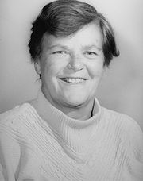

Branch and Bound
An algorithm design paradigm for optimization problems
The method was first proposed by Ailsa Land and Alison Doig
whilst carrying out research at the London School of Economics
sponsored by British Petroleum in 1960
The name "branch and bound" first occurred
in the work of Little et al. on the traveling salesman problem
Little, J. D., Murty, K. G., Sweeney, D. W., & Karel, C. (1963). An algorithm for the traveling salesman problem. Operations research, 11(6), 972-989.
https://dspace.mit.edu/bitstream/handle/1721.1/46828/algorithmfortrav00litt.pdf

Slide 3
Applications of Branch-and-Bound
This approach is used for a number problems
0/1 knapsack problem
Travelling salesman problem (TSP)
Feature selection in machine learning
Structured prediction in computer vision
Integer programming
Nonlinear programming
Quadratic assignment problem (QAP)
Maximum satisfiability problem (MAX-SAT)
Nearest neighbor search
Flow shop scheduling
Cutting stock problem
Computational phylogenetics
Parameter estimation
https://en.wikipedia.org/wiki/Branch_and_bound#cite_note-5

Slide 4
Branch and Bound (B&B)
0-1 Knapsack problem solved with
Dynamic programming (Section 4.5)
Backtracking algorithm (Section 5.7)
Both are exponential-time in the worst case
Can take many years to solve a particular instance
Another solution with Branch-and-Bound algorithm
Branch-and-Bound
an improvement on the Backtracking algorithm
Similarity
a state space tree used
Differences
not limited to a depth-first traversal of the state space tree
used only for optimization problems

Slide 5
Branch and Bound (B& B)
bound
B&B
computes a number (bound) at a node to
determine whether the node is promising
a bound on the value of the solution that
could be obtained by expanding beyond the node
If this bound is no better than the value of the best solution found so far
the node is nonpromising (bound <= bestValue): maximization problems
otherwise, promising
In some problems better mean ‘smaller’ or ‘larger’ (depending on the problem)
In minimization problems, if (bound >= bestValue) nonpromising node
B&B algorithms are mostly exponential-time (or worse) in the worst case, but
they can be very efficient for many large instances

Slide 6
Branch and Bound (B&B)
Backtracking algorithm for the 0-1 Knapsack problem (Section 5.7)
actually a branch-and-bound algorithm
the promising function returns false if the value of bound is not greater than the current value of maxprofit (bound <= maxprofit)
A backtracking algorithm does not exploit the real advantage of B&B
In B&B, we can compare the bounds of promising nodes and visit the children of the one with the best bound
faster than depth-first search
called best-first search with B&B pruning
implementation is a modification of breadth-first search with B&B pruning

Slide 7
Branch and Bound (B&B)
Breadth-first search
consists of visiting the root first, followed by all the nodes at level 1, then the nodes at level 2, etc.
Unlike depth-first search, no recursive algorithm
Implement using a queue
1
Visit the root first
Visit all nodes at level 1, followed by all nodes at level 2, …
At each level visit nodes from left to right
Level 1
2
3
4
Level 2
5
6
7
8
9
10
11
12
Level 3
13
14
15
16
Nodes are numbered in the order of a breadth-first traversal of the tree

Slide 8
General Algorithm for Breadth-first Search
enqueue(Q, v)
insert v at the end of the queue Q
dequeue(Q, v
Remove v from the front of queue Q
void bf_tree_search(tree T)
{
queue_of_node Q;
node u,v;
initialize(Q); //make it empty
v = root of T;
visit v;
enqueue(Q, v);
while (!empty(Q)) {
dequeue(Q, v);
for (each child u of v) {
visit u;
enqueue(Q, u);
}
}
}
Q: 1
while 1st pass
while 2nd pass
Q: null; v =1
Q: 3,4; v = 2
After for loop:
Q: 2,3,4
After for loop:
Q: 3,4,5,6,7
1
2
3
4
5
6
7
8
9
10
11
12
13
14
15
16

Slide 9
6.1. Branch-and-Bound with the 0-1 Knapsack Problem
First we discuss a simple version
Breadth-first search with B&B pruning (6.1.1.)
After that, we show another approach
Best-first search with B&B pruning (6.1.2.)

Slide 10
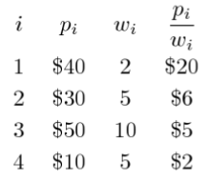
6.1.1. Breadth-First Search for 0-1 Knapsack Pb. Using B&B
Example: 4 items and maximum weight W = 16
Same as Example 5.6 except that we do BFS instead of DFS
(0,0)
Exclude Item 1
$0
0
$115
Include Item 1
Item 1
$40
2
(1,1)
(1,2)
P₁/w₁ = 20
$40
2
$115
$0
0
$82
Item 2
$30
5
(2,1)
(2,2)
(2,3)
(2,4)
P₂/w₂ = 6
$70
7
$115
$40
2
$98
$30
5
$82
$0
0
$60
Item 3
$50
10
Total profits so far
(3,1)
(3,2)
(3,3)
(3,4)
(3,5)
(3,6)
P₃/w₃ = 5
$120
17
$0
$70
7
$80
$90
12
$98
$40
2
$50
$80
15
$82
$30
5
$40
Total weight so far
Item 4
$10
5
(4,1)
(4,2)
(4,3)
(4,4)
P₄/w₄ = 2
$80
12
$80
$70
7
$70
$100
17
$0
$90
12
$90
Bound on total profits

Slide 11
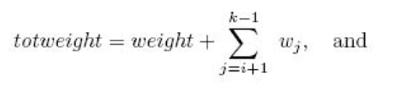
The 0-1 Knapsack Problem (slide from Chapter 5)
Weight: The sum of weights of the items that have been included up to some node
Profit: The sum of the profits of the items included up to the node
A node is non promising if
the weight of items chosen is greater than W (weight ≥ W)
it is nonpromising even if weight equals W because in optimization problems, promising means that we should expand to the children
We initialize bound and totweight to profit and weight, respectively
Then, we greedily grab items, adding their weights and profits to totweight and bound, until we reach an item whose weight would bring totweight above W
We grab the fraction of that item allowed by the available weight, and add the profit of that fraction to bound
If maxprofit is the value of the profit in the best solution found so far, then a node at level i is nonpromising if bound ≤ maxprofit

Slide 12
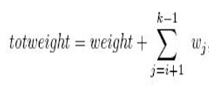
Summary of the Approach (slide from Chapter 5)
Non-promising cases
weight ≥ W
bound ≤ maxprofit
Equations

Slide 13
General Algorithm for Breadth-First Search with B&B
void bf_bb(State_Space_Tree T,
number& best)
{
queue_of_node Q;
node u,v;
initialize(Q);
v = root of T;
visit v;
enqueue(Q,v);
best = value(v);
while (!empty(Q)) {
dequeue(Q,v);
for (each child u of v) {
if (value(u) is better than best)
best = value(u);
if (bound(u) is better than best)
enqueue(Q,u);
}
}
}
Initialize Q to be empty
Visit the root node
Current best solution is initialized to the value of the solution at the root
Visit each child
We visit a node’s children only if its bound is better than the value of the current best solution
We often do not write a function value
We simply compute the value directly

Slide 14

A Summary on the Processing of Child Items with BFS
When doing a breadth-first search
if they are promising
we place child items into a queue for later processing
If they are non-promising
we leave them out of the queue
so that branch will not be processed

Slide 15
A Specific Algorithm for the 0-1 Knapsack Problem
We do not have the benefit of recursion
we do not have new variables being created at each recursive call
we must store all the information at the node
Nodes in the algorithm will have the following type
struct node
{
int level;
int profit;
int weight;
};
Java doesn't have structs like C/C++
you can use Java classes and treat them like a struct
you can, of course, declare all its members as public (to work exactly like a struct)

Slide 16
Breadth-First Search with B&B for the 0-1 Knapsack problem (Alg. 6.1.)
void knapsack2(int n, const int p[], const int w[], int W, int& maxprofit) {
queue_of_node Q;
node u,v;
initialize(Q);
v.level = 0; v.profit = 0; v.weight = 0;
maxprofit = 0;
enqueue(Q,v);
while (!empty(Q)) {
dequeue(Q,v);
u.level = v.level + 1;
u.weight = v.weight + w[u.level];
u.profit = v.profit + p[u.level];
if (u.weight <= W && u.profit > maxprofit)
maxprofit = u.profit;
if (bound(u) > maxprofit)
enqueue(Q,u);
u.weight = v.weight; u.profit = v.profit;
if (bound(u) > maxprofit)
enqueue(Q,u);
}
}
//Output is maxprofit
Initialize Q to be empty
Initialize v to be the root
Set u to a child of v
Set u to the child that includes the next item (1)
We add the child item to the queue if it is promising
Set u to the child that does not include the next item (0)

Slide 17
bound function
Function bound is the same as function promising in Algorithm 5.7
Difference
bound was written according to guidelines for creating B&B algorithms
therefore, returns an integer
Function promising returns a Boolean because it was written based on Backtracking guidelines

Slide 18
float bound (node u) {
index j,k
int totweight;
float result;
if (u.weight >= W)
return 0;
else {
result = u.profit;
j = u.level + 1;
totweight = u.weight;
while(j ≤ n && totweight + w[j] ≤ W){
totweight = totweight + w[j];
result = result + p[j];
j+ +;
}
k = j;
if (k <= n)
result = result + (W - totweight) * p[k]/w[k];
return result;
}
}
Node is promising only if we should expand to its children. There must be some capacity left for the children
Result is used to represent the bound value
Grab as many items as possible
Use k for consistency with formula in the textbook
Grab fraction of the kth item

Slide 19
6.1.2. Best-First Search with Branch-and-Bound Pruning
Breadth-First Search strategy has no advantage over a DFS (backtracking)
However, we can improve our search by using our bound to do more than just determine whether a node is promising
We can look at all the promising nodes and
expand beyond the one with the best bound
We often arrive at an optimal solution more quickly
e.g., we will check the node’s bound value against the maxProfit
[Recall that a node is promising if its bound is better than the value of the best solution found so far]
Best Bound

Slide 20
Best-First Search for 0-1 Knapsack Pb. using B&B
Example: 4 items and maximum weight W = 16
(0,0)
Exclude Item 1
$0
0
$115
Include Item 1
Item 1
$40
2
(1,1)
(1,2)
P₁/w₁ = 20
$40
2
$115
$0
0
$82
Item 2
$30
5
(2,1)
(2,2)
115 vs. 82
(1,1) has the greatest bound
P₂/w₂ = 6
$70
7
$115
$40
2
$98
Item 3
$50
10
(3,1)
(3,2)
(3,3)
(3,4)
Total profits so far
P₃/w₃ = 5
$120
17
$0
$70
7
$80
$90
12
$98
$40
2
$50
Total weight so far
Item 4
$10
5
(4,3)
(4,4)
P₄/w₄ = 2
Bound on total profits
$100
17
$0
$90
12
$90

Slide 21
Test Run of the 0-1Knapsack Best-First Algorithm
1) Visit node (0,0)
a) prft = $0; wght = 0;
b) bond = $115
c) maxprft = 0;
2) Visit node (1,1)
a) prft = $40; wght = 2;
b) maxprft = $40;
c) bond = $115
3) Visit node (1,2)
a) prft = $0; wght = 0;
b) bond = $82
4) Find prom. not expanded
higher bond node: (1,1)
a) visit child of (1,1)
5) Visit node (2,1)
a) prft = $70; wght = 7;
b) maxprft = $70;
c) bond = $115
6) Visit node (2,2)
a) prft = $40; wght = 2;
b) bond = $98
7) Find prom. not expanded
higher bond node: (2,1)
a) visit child of (2,1)
8) Visit node (3,1)
a) prft = $120; wght =17;
b) non prom.
c) bond = $0
9) Visit node (3,2)
a) prft = $70; wght = 7;
b) bond = $80;
10) Find prom. not expanded
higher bond node: (2,2)
a) visit child of (2,2)
11) Visit node (3,3)
a) prft = $90; wght = 12;
b) maxprft = $90;
c) (1,2) , (3,2) become
non prom.
d) bond = $98;
12) Visit node (3,4)
a) prft = $40; wght =2;
b) bond = $50
c) non prom.
13) Find prom. not expanded
higher bond node: (3,3)
a) visit child of (3,3)
14) Visit node (4,1)
a) prft = $100; wght = 17;
b) non prom.
c) bond = $0;
15) Visit node (4,2)
a) prft = $90; wght = 12;
b) bond = $90;
c) non prom.
No more promising
unexpanded nodes !
Done

Slide 22
Best-First Search for 0-1 Knapsack Pb. using B&B
Best First Search: we checked only 11 nodes
Breadth-First Search: 17 nodes
Depth-First Search: 13 nodes
A savings of 2 nodes (13-11=2) is not very impressive
however, in a large state space tree, the savings can be very significant
The implementation of best-first search
a simple modification to breadth-first search
instead of using a queue, we use a priority queue

Slide 23
General Algorithm for Best-First Search using B&B
void bestf_bb(State_Space_Tree T, number& best)
{
priority_queue_of_node PQ;
node u,v;
initialize(PQ);
v = root of T;
insert(PQ,v);
best = value(v);
while (!empty(PQ)) {
remove(PQ,v);
if (bound(v) is better than best)
for (each child u of v) {
if (value(u) is better than best)
best = value(u);
if (bound(u) is better than best)
insert(PQ,u);
}
}
}
Initialize PQ to be empty
insert(PQ, v)
adds v to the priority queue PQ
remove(PQ, v)
removes the node with the best bound and assigns its value to v
Remove node with best bound
Check if node is still promising
Different than BFS
In this way, we avoid visiting children of a node that becomes nonpromising after it is visited

Slide 24
Best-First Search B&B vs. Breadth-First Search B&B
void bestf_bb(State_Space_Tree T,
number& best)
{
priority_queue_of_node PQ;
node u,v;
initialize(PQ);
v = root of T;
insert(PQ,v);
best = value(v);
while (!empty(PQ)) {
remove(PQ,v);
if (bound(v) is better than best)
for (each child u of v) {
if (value(u) is better than best)
best = value(u);
if (bound(u) is better than best)
insert(PQ,u);
}
}
}
void breadthf_bb(State_Space_Tree T,
number& best)
{
queue_of_node Q;
node u,v;
initialize(Q);
v = root of T;
enqueue(Q,v);
best = value(v);
while (!empty(Q)) {
dequeue(Q,v);
for (each child u of v) {
if (value(u) is better than best)
best = value(u);
if (bound(u) is better than best)
enqueue(Q,u);
}
}
}

Slide 25
Specific Algorithm for the 0-1 Knapsack Problem
We need the bound for a node
at the insertion time
at removal time
to order the nodes in the priority queue
Nodes in the algorithm will have the following type
struct node
{
int level;
int profit;
int weight;
float bound;
};

Slide 26
void knapsack3(int n, const int p[], const int w[], int W, int& maxprofit) {
priority_queue_of_node PQ; node u,v; initialize(PQ);
v.level = 0; v.profit = 0; v.weigth = 0;
maxprofit = 0;
v.bound = bound(v);
insert(PQ,v);
while (!empty(PQ)) {
remove(PQ,v);
if (v.bound > maxprofit) {
u.level = v.level + 1;
u.weight = v.weight + w[u.level];
u.profit = v.profit + p[u.level]:
if (u.weight <= W && u.profit > maxprofit)
maxprofit = u.profit;
u.bound = bound(u);
if (u.bound > maxprofit)
insert(PQ,u);
u.weight = v.weight; u.profit = v.profit;
u.bound = bound(u);
if (u.bound > maxprofit)
insert(PQ,u);
}
}
}
Initialize PQ to be empty
Initialize v to be the root
Remove node with best bound
Check if node is still promising
Set u to the child that includes the next item (1)
We visit a node’s children only if its bound is better than the value of the current best solution
Set u to the child that does not include the next item (0)

Slide 27
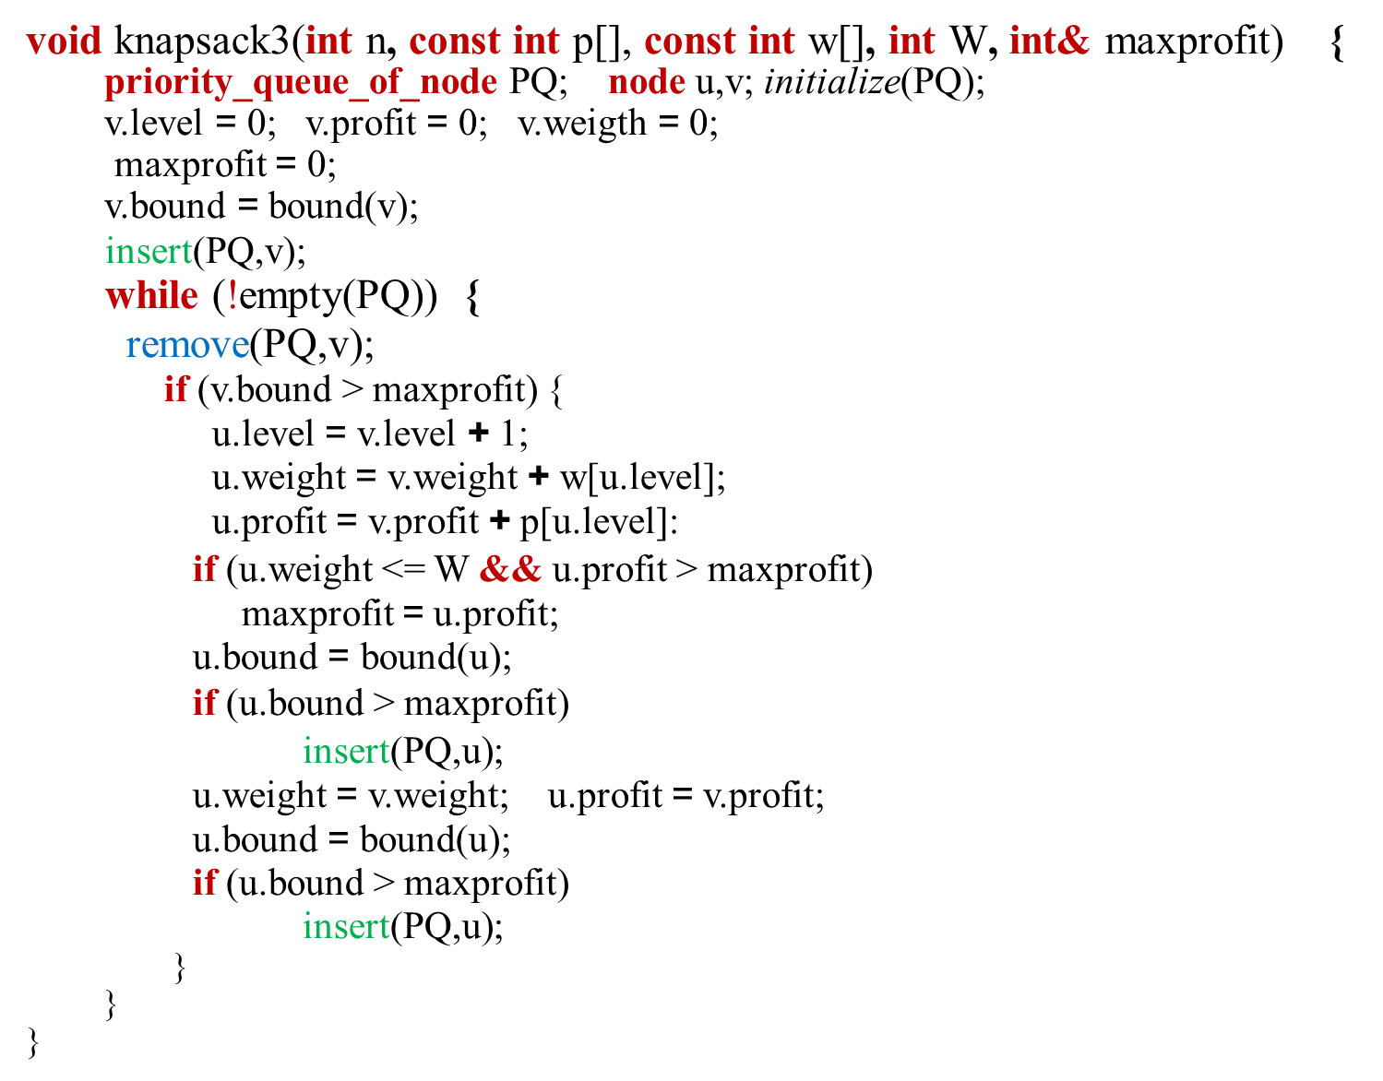
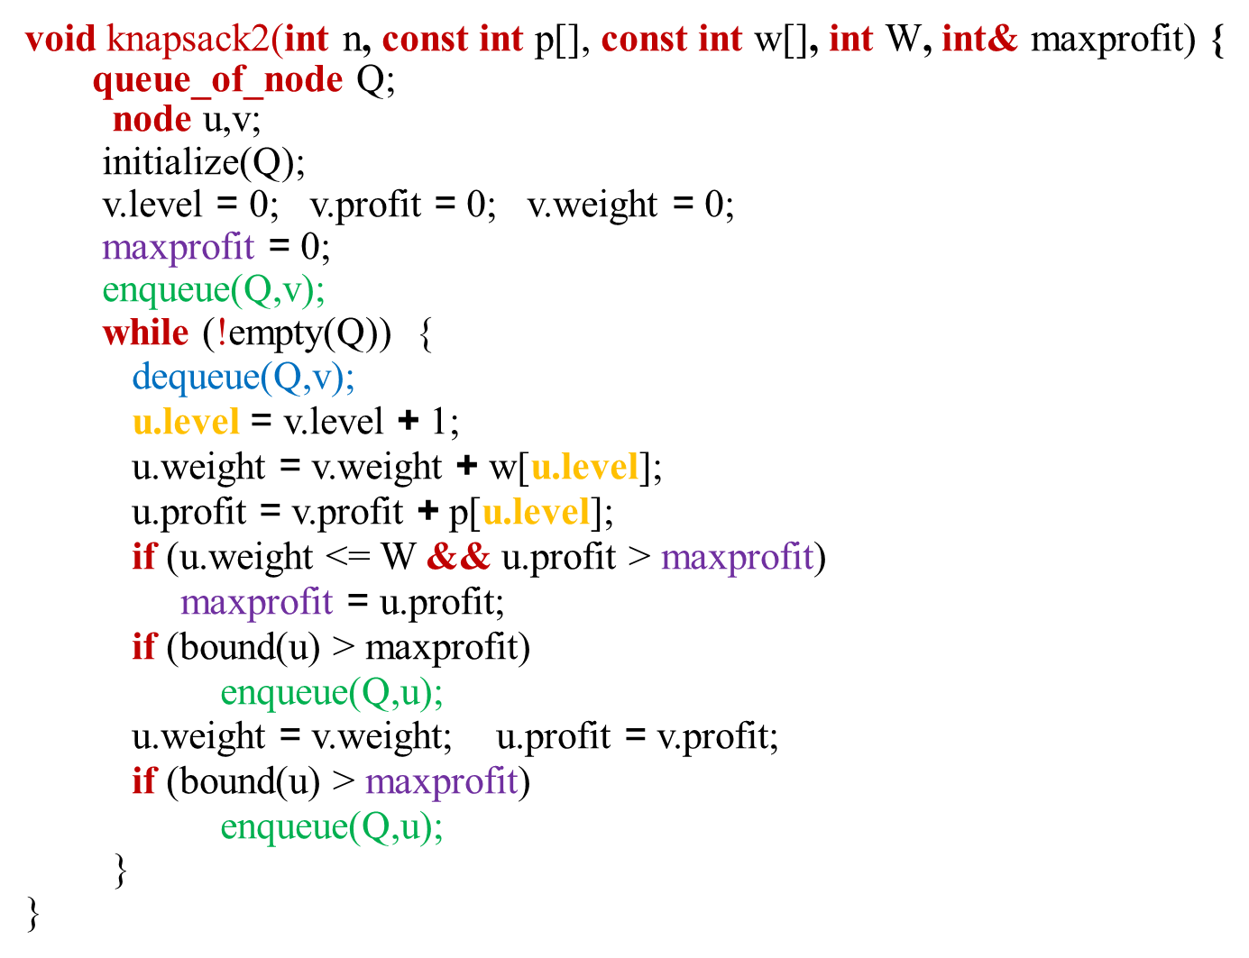
Best-First Search B&B vs. Breadth-First Search B&B for 0-1 Knapsack

Slide 28
float bound (node u) {
index j,k
int totweight;
float result;
if (u.weight >= W)
return 0;
else {
result = u.profit;
j = u.level + 1;
totweight = u.weight;
while(j ≤ n && totweight + w[j] ≤ W){
totweight = totweight + w[j];
result = result + p[j];
j+ +;
}
k = j;
if (k <= n)
result = result + (W - totweight) * p[k]/w[k];
return result;
}
}
THE SAME BOUND FUNCTION IS USED
Grab as many items as possible
Use k for consistency with formula in the textbook
Grab fraction of the kth item

Slide 29
Quick Check
In branch-and-bound problem, we are limited in a fixed way to traverse the tree (True or False)
False
Since the 0-1 Knapsack problem is a(n) ……………problem, we can use branch and bound for it
Optimization
In best-first search, unlike breadth-first search, we put items into a(n) …………….
Priority queue

Slide 30
6.2. The Traveling Salesperson Problem
We last saw Nancy in Section 5.6
Her sales territory was expanded to 40 cities
She used Backtracking algorithm for the Hamiltonian Circuits problem
Even if she finds a tour efficiently, that tour could be far from optimal
So, she wants to apply the Branch-and-Bound algorithm
Goal
Find the shortest path in a directed graph
Starts at a given vertex, visits each vertex exactly once, and ends up back at the starting vertex

Slide 31
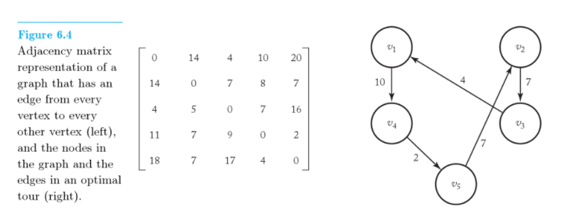
6.2. The Traveling Salesperson Problem
Optimal Tour

Slide 32
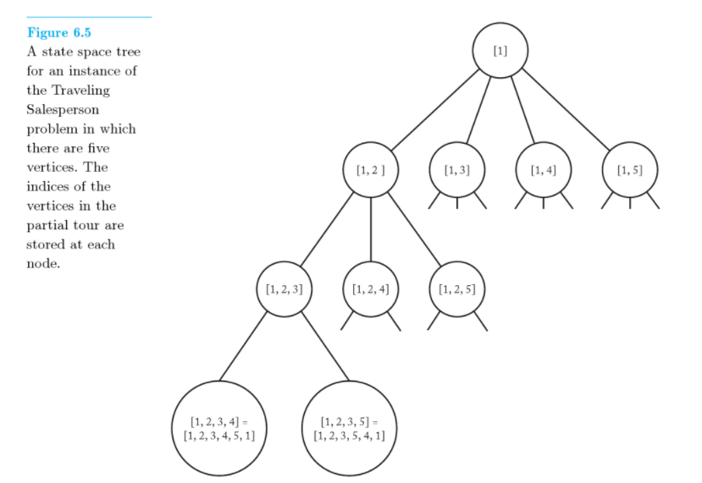
6.2. The Traveling Salesperson Problem
A node that is not a leaf represents all those tours that start with the path stored at that node
node [1, 2, 3] represents [1, 2, 3, 4, 5, 1] and [1, 2, 3, 5, 4, 1]
Each leaf represents a tour
We must find a leaf that contains an optimal tour

Slide 33
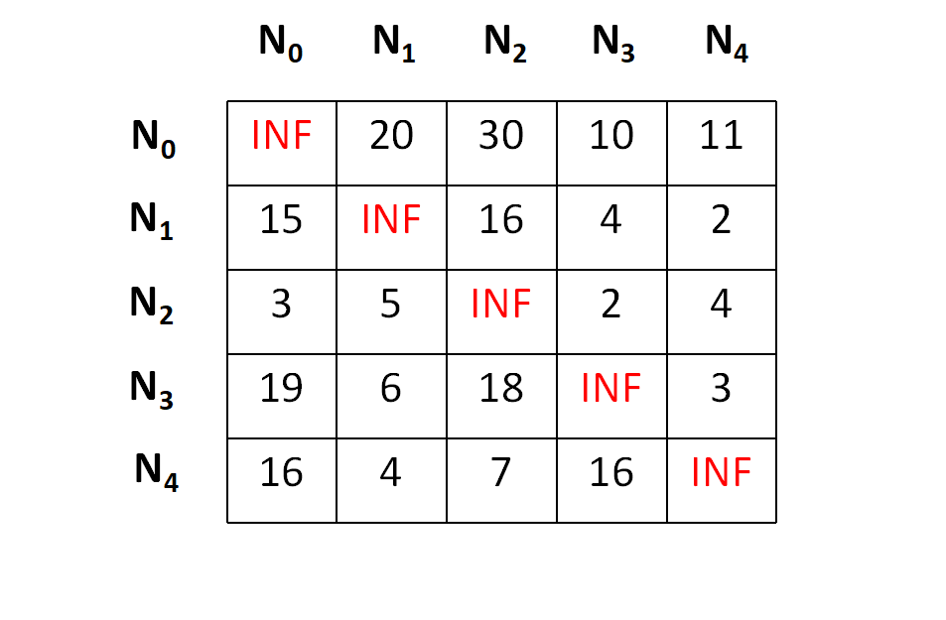
Additional Example
https://iq.opengenus.org/travelling-salesman-branch-bound/

Slide 34
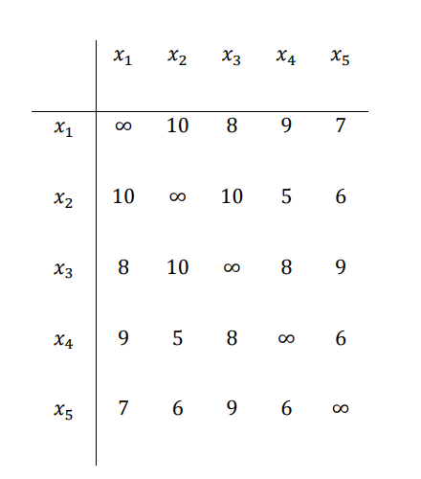
In-Class Exercise
What is the minimum cost of the TSP problem using the given adjacency matrix?
Apply B&B technique and calculate cost of each node
X1
C=?, minLength = INF
X2
X3
X4
X5
C=?
C=?
C=?
C=?

Slide 35
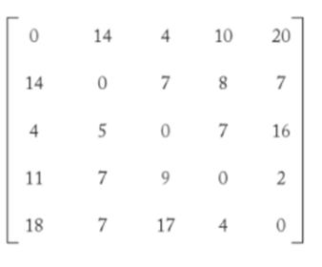
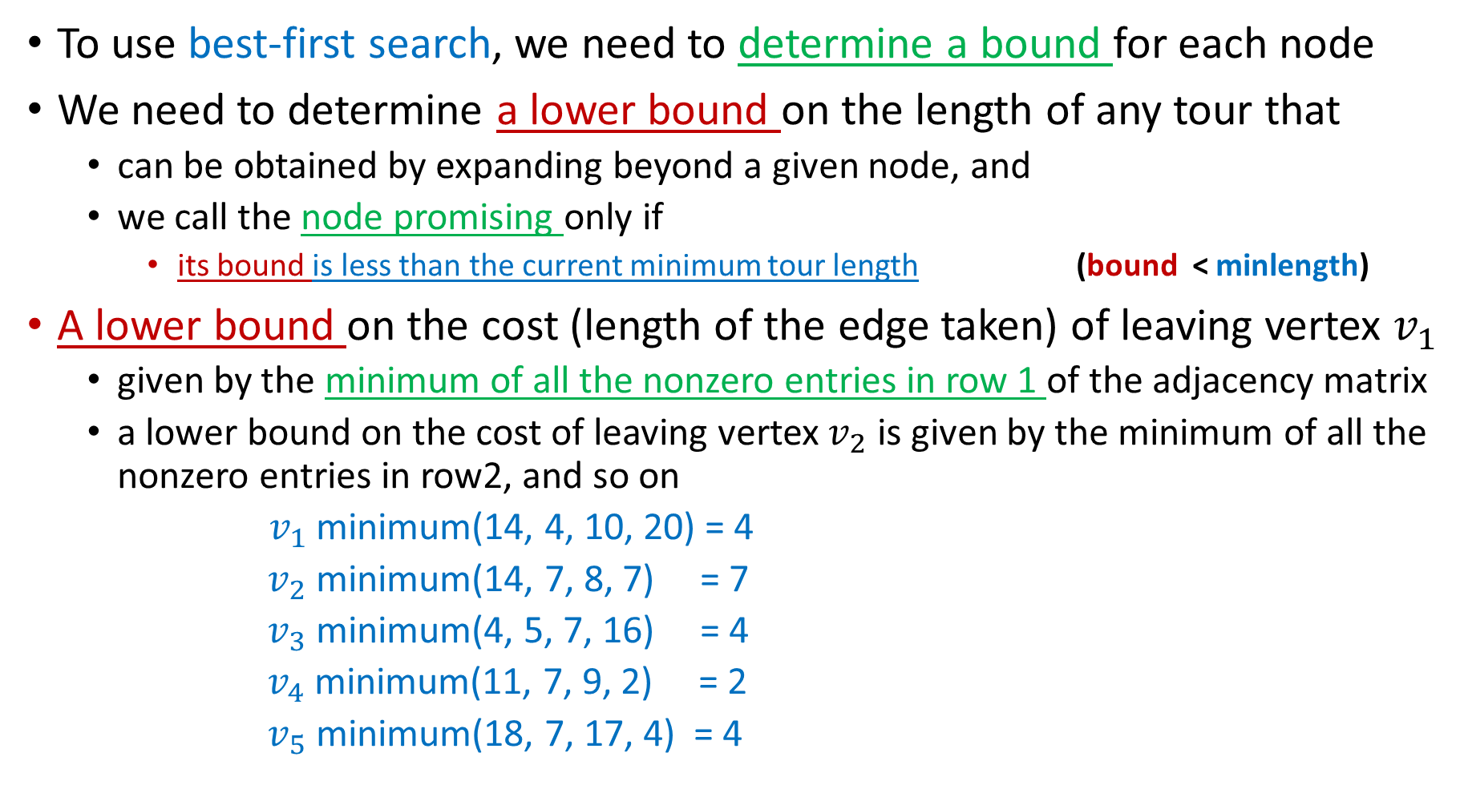
6.2. The Traveling Salesperson Problem
To use best-first search, we need to determine a bound for each node
We need to determine a lower bound on the length of any tour that
can be obtained by expanding beyond a given node, and
we call the node promising only if
its bound is less than the current minimum tour length (bound < minlength)
A lower bound on the cost (length of the edge taken) of leaving vertex $v_{1}$
given by the minimum of all the nonzero entries in row 1 of the adjacency matrix
a lower bound on the cost of leaving vertex $v_{2}$ is given by the minimum of all the nonzero entries in row2, and so on
${ v}_{1}$ minimum(14, 4, 10, 20) = 4
$v_{2}$ minimum(14, 7, 8, 7) = 7
$v_{3}$ minimum(4, 5, 7, 16) = 4
$v_{4}$ minimum(11, 7, 9, 2) = 2
$v_{5}$ minimum(18, 7, 17, 4) = 4

Slide 36
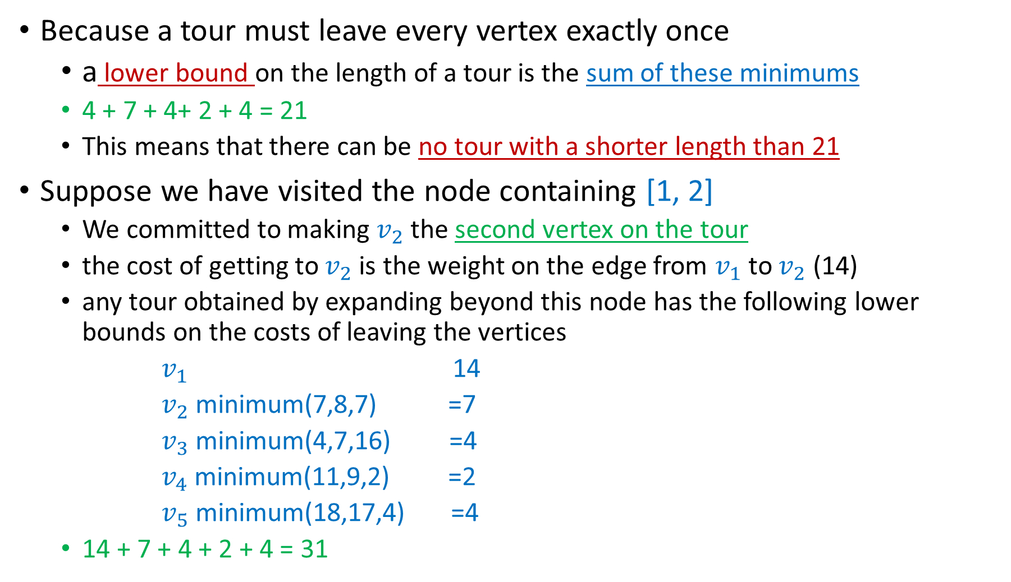
6.2. The Traveling Salesperson Problem
Because a tour must leave every vertex exactly once
a lower bound on the length of a tour is the sum of these minimums
4 + 7 + 4+ 2 + 4 = 21
This means that there can be no tour with a shorter length than 21
Suppose we have visited the node containing [1, 2]
We committed to making $v_{2}$ the second vertex on the tour
the cost of getting to $v_{2}$ is the weight on the edge from $v_{1}$ to $v_{2}$ (14)
any tour obtained by expanding beyond this node has the following lower bounds on the costs of leaving the vertices
$v_{1}$ 14
$v_{2}$ minimum(7,8,7) =7
$v_{3}$ minimum(4,7,16) =4
$v_{4}$ minimum(11,9,2) =2
$v_{5}$ minimum(18,17,4) =4
14 + 7 + 4 + 2 + 4 = 31
Check the next slides to see why we do not include some values!

Slide 37

6.2. The Traveling Salesperson Problem
To obtain the minimum for $v_{2}$ we do not include the edge to $v_{1}$ because
we cannot return to $v_{1}$
To obtain the minimums for the other vertices
we do not include the edge to $v_{2}$
because we have already been at $v_{2}$

Slide 38
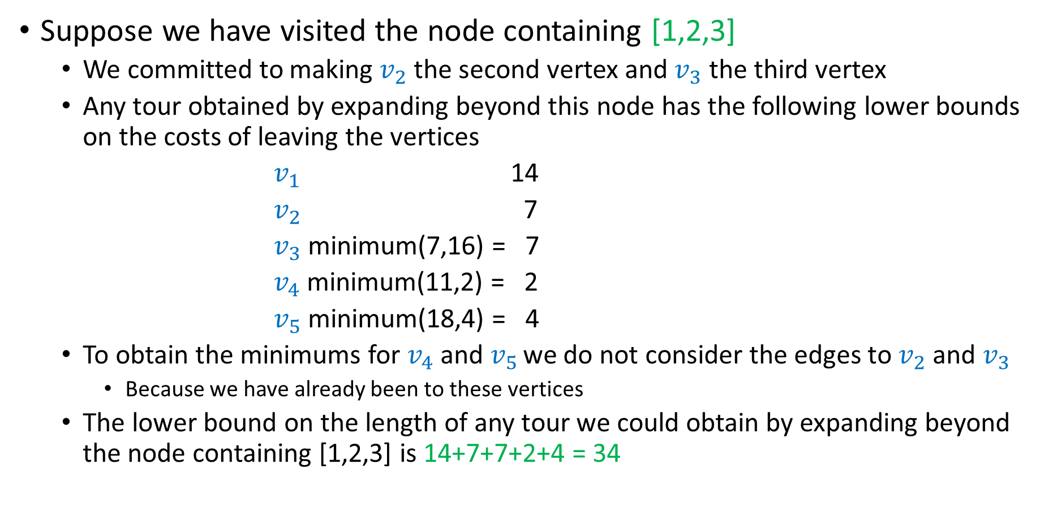
6.2. The Traveling Salesperson Problem
Suppose we have visited the node containing [1,2,3]
We committed to making $v_{2}$ the second vertex and $v_{3}$ the third vertex
Any tour obtained by expanding beyond this node has the following lower bounds on the costs of leaving the vertices
$v_{1}$ 14
$v_{2}$ 7
$v_{3}$ minimum(7,16) = 7
$v_{4}$ minimum(11,2) = 2
$v_{5}$ minimum(18,4) = 4
To obtain the minimums for $v_{4}$ and $v_{5 }$we do not consider the edges to $v_{2}$ and $v_{3}$
Because we have already been to these vertices
The lower bound on the length of any tour we could obtain by expanding beyond the node containing [1,2,3] is 14+7+7+2+4 = 34

Slide 39
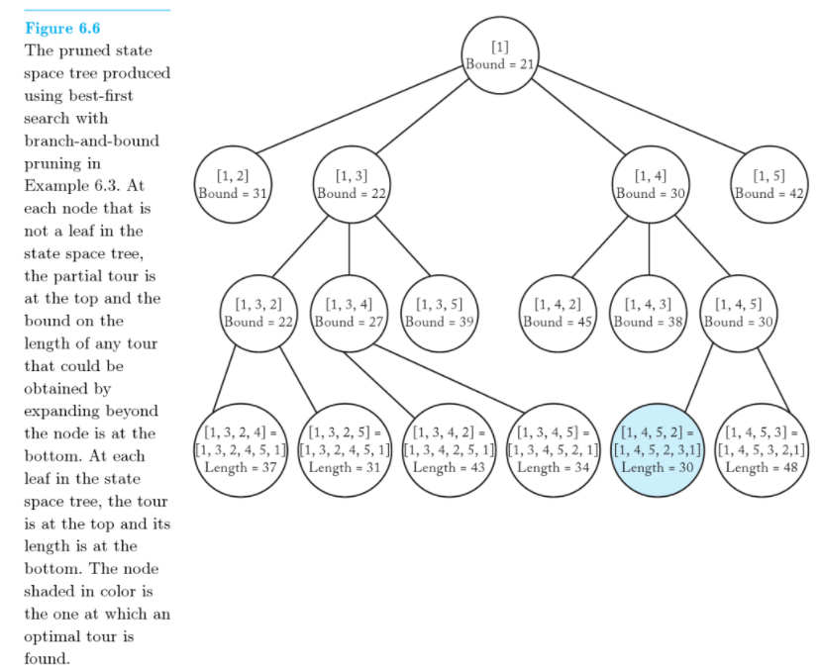
Example 6.3. (page 266) Best-First Search with B&B

Slide 40
Example 6.3
The bound is stored at a nonleaf
The length of the tour is stored at a leaf
We initialize the value of the best solution to infinity because there is no candidate solution at the root

Slide 41
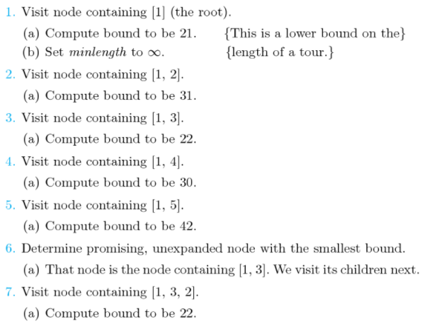
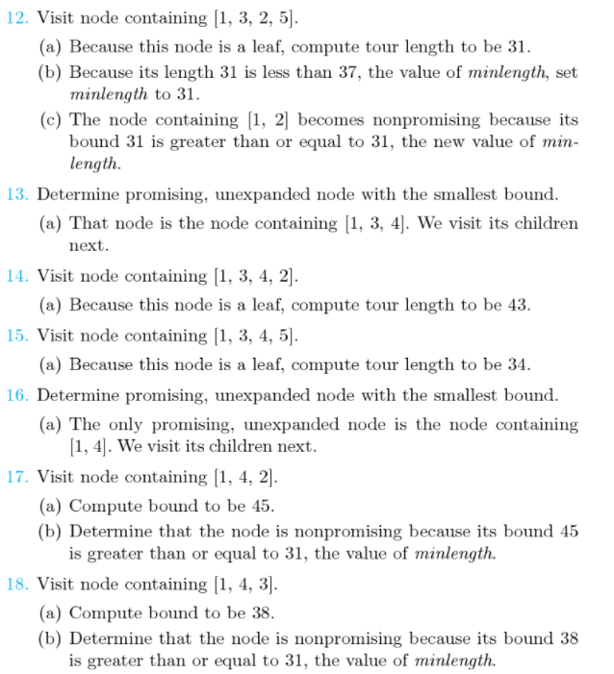
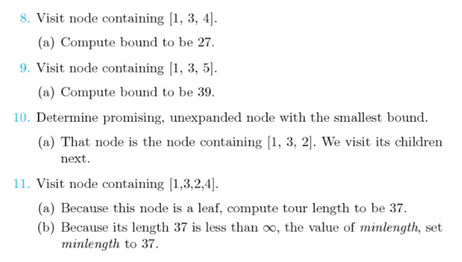

Slide 42
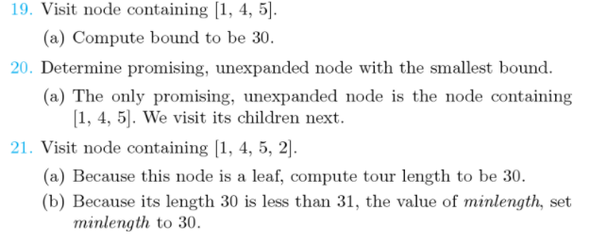
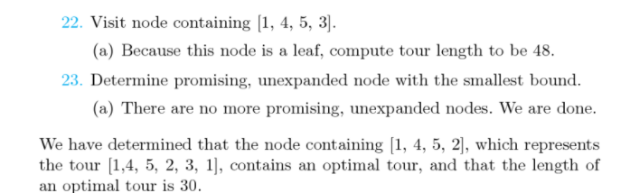

Slide 43
Best-First Search with B&B for the Traveling Salesperson
The following data type is used
struct node
{
int level;
ordered_set path; //partial tour stored at the node (e.g., [1, 2])
number bound;
}

Slide 44
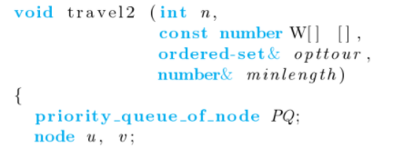
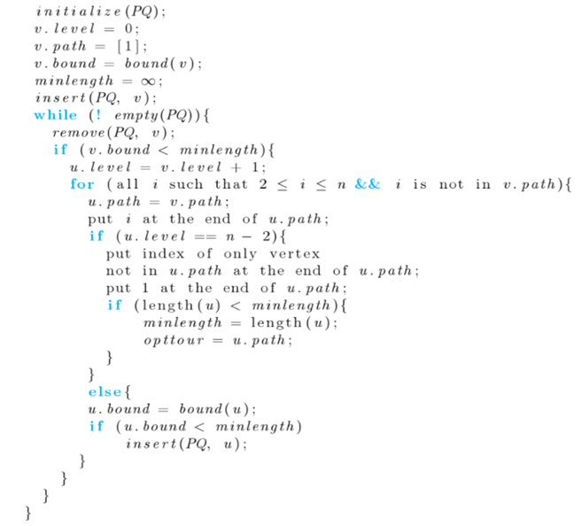
Initialize PQ to be empty
Initialize v to be the root
Remove node with best bound
Check if node is still promising
Set u to a child of v
Try all possible nodes as the next node
Check if next vertex completes a tour
Make first vertex last one
Function length computes the length of tour
We visit a node’s children only if its bound is better than the value of the current best solution

Slide 45
Best-First Search with B&B for the Traveling Salesperson
If B&B cannot solve Nancy’s problem efficiently
she can try Approximation algorithms
Approximation Algorithms (section 9.5)
Not guaranteed to yield optimal solutions but
Rather yield solutions that are reasonably close to optimal

